Slide 1
DRUGS USED IN THE TREATMENT OF AFFECTIVE DISORDERS

Slide 2
Disorders of the mood
Depression
Mania
Manic depressive psychosis

Slide 3
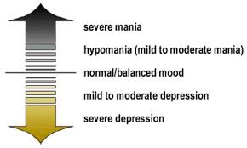

Slide 4
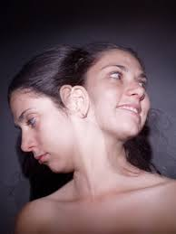

Slide 5
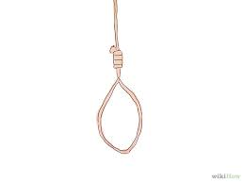

Slide 6
Depression and anti depressanats
monoamine hypothesis
  endogenous depression is due to deficiency of CNS noradrenergic or serotonergic activity or transmission
drugs used in depression elevates the level of these

Slide 7
Antidepressanats
Tricyclic antidepressants
Monoamine oxidase inhibitors(MAO)
Selective serotonin reuptake inhibitors(SSRI)
SSNRI

Slide 8
Tricyclic antidepressanats
Inhibit the reuptake of noradrenaline and 5 hydroxytryptamine in brain.
Take a week or more to show there antidepressant effect
Have anticholinergic and anti histaminic effects.
Best given one daily oral dose at night
treatment is usually started with a small dose at night and increased at 2 weekly intervals.

Slide 9
Indications for use
Depression
Neuralgias
Anxiety states/PTSD
Nocturnal enuresis in children
Irritable bowel syndrome
Some forms of headache
Eating disorers
Premenstrual symptoms/Vasomotor symptoms of menepause

Slide 10
Adverse effects
Dry mouth,blurring of vision,constipation and difficulty in micturition
CVS effects tachycardia. Arhythmias
May precipitate epilepsy
confusion in the elderly

Slide 11
Choice of tricyclic
Amitriptyline is sedating and preferred in patients with insomnia.
Imipramine is less sedating
Mianserin,Trazadone is preferred in patients with IHD

Slide 12
Monoamine oxidase inhibitors
MAO is one of the two main enzymes involved in the metabolism of 5HT and catecholamines
Used in endogenous depression not responding to other medication
Tyramine containing foods like cheese, vines and fruits produce a hypertensive reaction “cheese reaction”
eg Phenelzine. Isocarboxacid

Slide 13
SSRI’s
Less side effects compared to Tricyclics and MAO inhibitors specially anticholinergic effects
Doesn’t offer greater efficacy than TCA in depression
eg Fluoxetine, Fluvoxamine, Paroxetine

Slide 14
SSRI’S Cont
Used in Depression, Panic disorders,CAD Bulimia nervosa, Obsessive compulsive disorder and social phobias.
Gastrointestinal side effects are common
Start should be delayed by 2 weeks if patient was on MAO
Venlafaxine is a SNRI used in depression anxiety disorder
Mirtazapine a tetracyclic antidepressant

Slide 15
Drugs used in manic depressive psychoses
Lithium
Carbamazepine

Slide 16
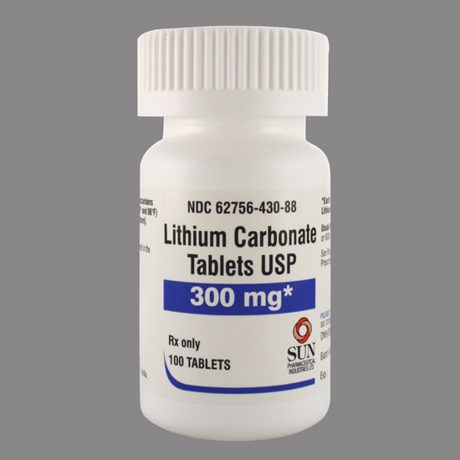

Slide 17
Lithium
Effective in the prophylaxis of manic depressive psychoses,unipolar depression and treatment of acute mania
Well absorbed from the gut and eliminated unchanged in urine
Has a narrow therapeutic index.
Needs the monitoring of plasma concentrations
CNS side effects like tremor ,giddiness and ataxia may be the early features of toxicity.

Slide 18
Carbamazepine
Used in the prophylaxis of manic depressive psychoses
Used In patients who cannot tolerate lithium or who do not respond to lithium
Sodium valproate is also useful

Slide 19
Summary
Treatment of depression
Treatment of manic depressive psychosis

